Slide 1
Food Safety in Chengdu
By: A16 Group 11
（1）王延 201822021745：Current situation of food safety
（2）郝晓林 201821020633：Importance and hazards
（3）杨庆 201822090316：Solution measures

Slide 2
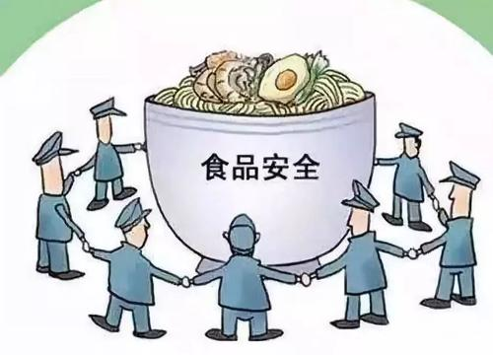
Food Safety in Chengdu
1.Broad topic：Food Safety in Chengdu
2.Specific topic：
（1）Current situation of food safety.
（2）Importance and hazards.
（3）Solution measures.
3.We believe that this relates to Green Chengdu in the following ways:
（1）The current situation of food safety in Chengdu is worrying.
（2）The harm of food safety cannot be underestimated.
（3）Some measures must be taken to avoid food safety problems.

Slide 3
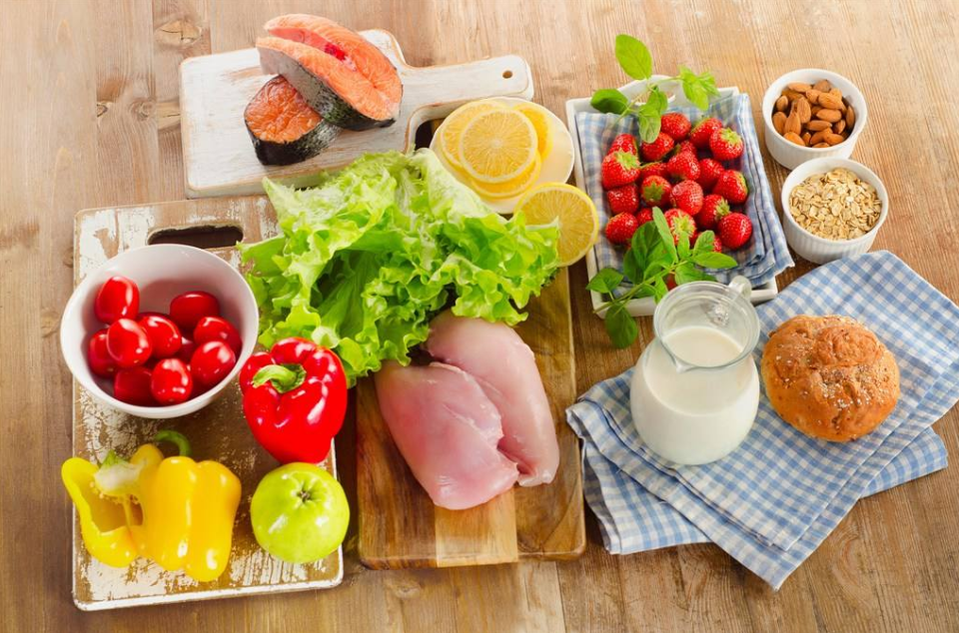
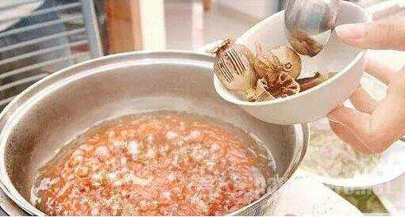
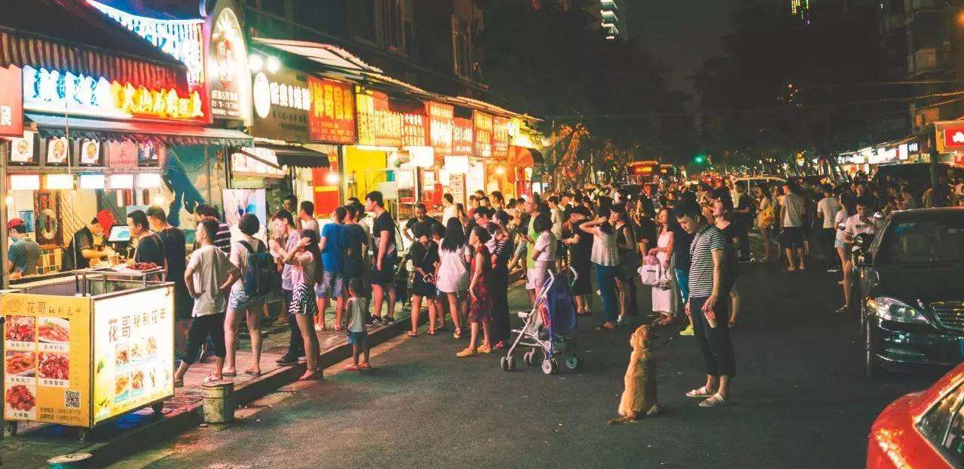
王延-Current Situation of Food Safety in Chengdu
The quality of agricultural and livestock fish products determines the quality level of the final food.
The lack of social responsibility of producers is also one of the reasons.
Consumers’ lack of common sense in food safety is also one of the reasons.

Slide 4
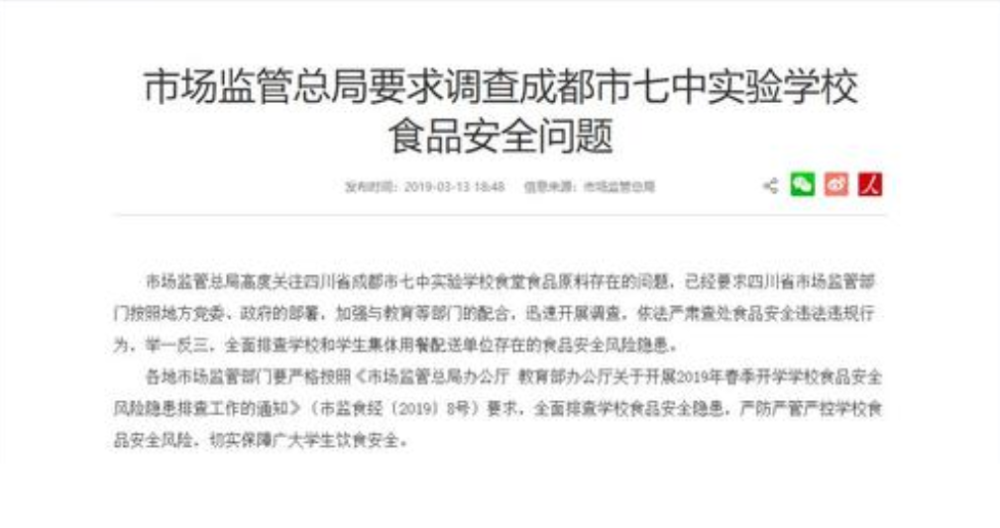

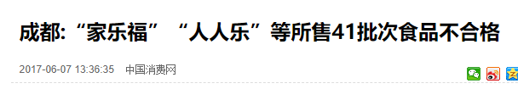
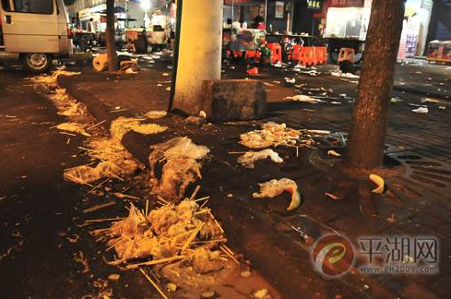
郝晓林-hazards of food safety issues and the importance of food safety
Issues of food safety will produce great harm to the human body.
Issues of food safety will destroy social stability and harmony.
Issues of food safety affect the environment.

Slide 5
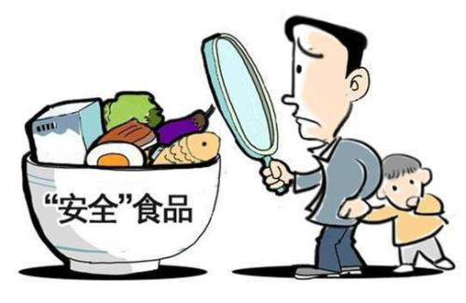
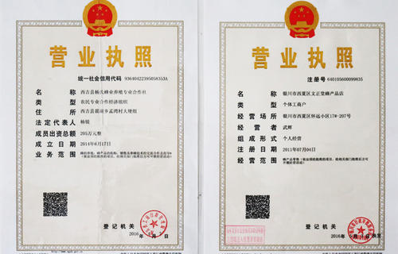
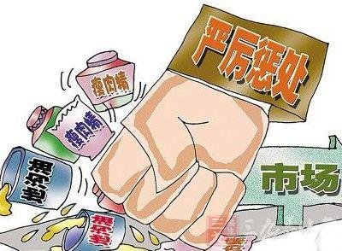
杨庆-Solution Measures to Food Safety Problems in Chengdu
1. Consumers ：
Consumers should improve discrimination ability and cultivate food safety awareness.
2. Businesses ：
Businesses should not sell illegal food and contaminated food.
3. Government ：
The government should establish various laws and regulations to strengthen the inspection and supervision of food safety.

